Slide 1
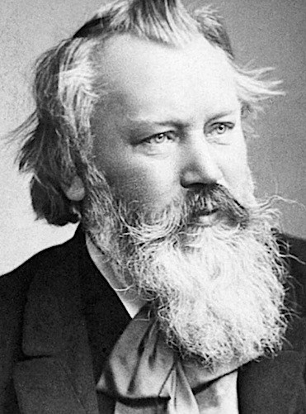
Name: Hungarian Dance # 5
Composer: Johannes Brahms (1833-1897)
Form:
A – Floor, Together, Side, Together x3
Fan x4, Floor and Slide
B – Brushes, Shimmer x2, dishes, clap
C – Head, Head, Snaky Arms, Head
A – Floor, Together, Side, Together x3
Fan x4, Floor and Slide
B – Brushes, Shimmer x2, dishes, clap
Coda – Lap, Clap, Up

Slide 2
