Slide 1
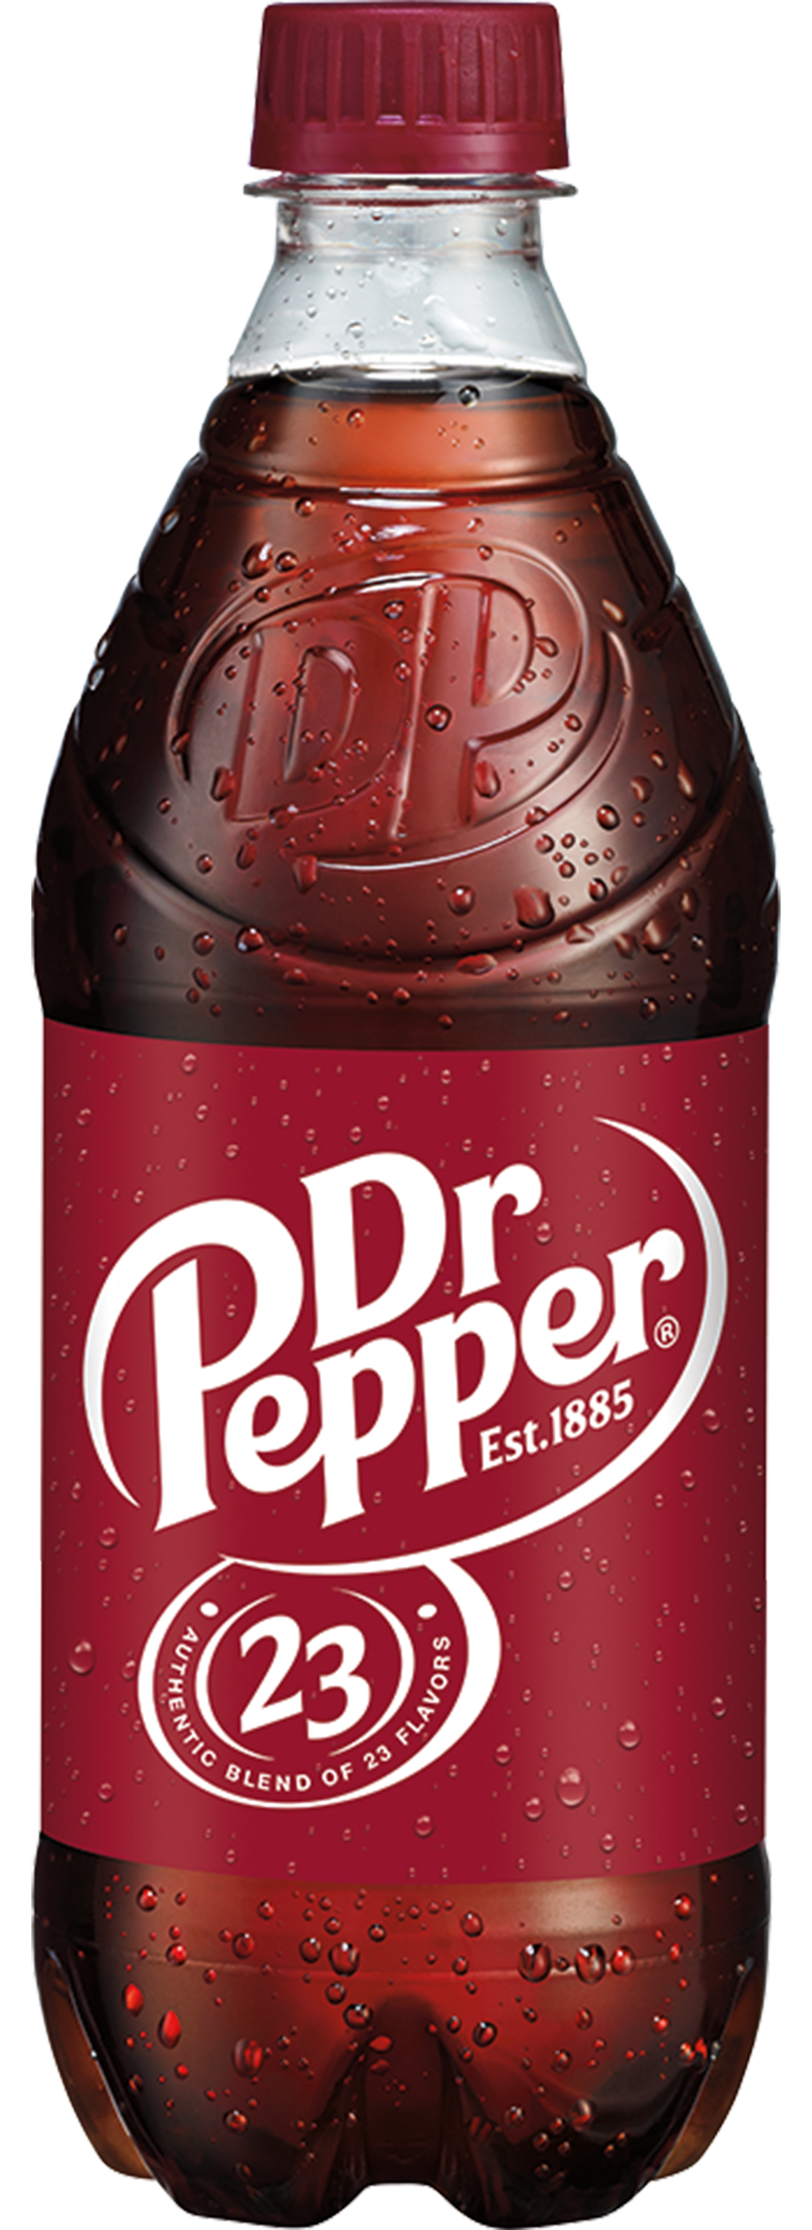
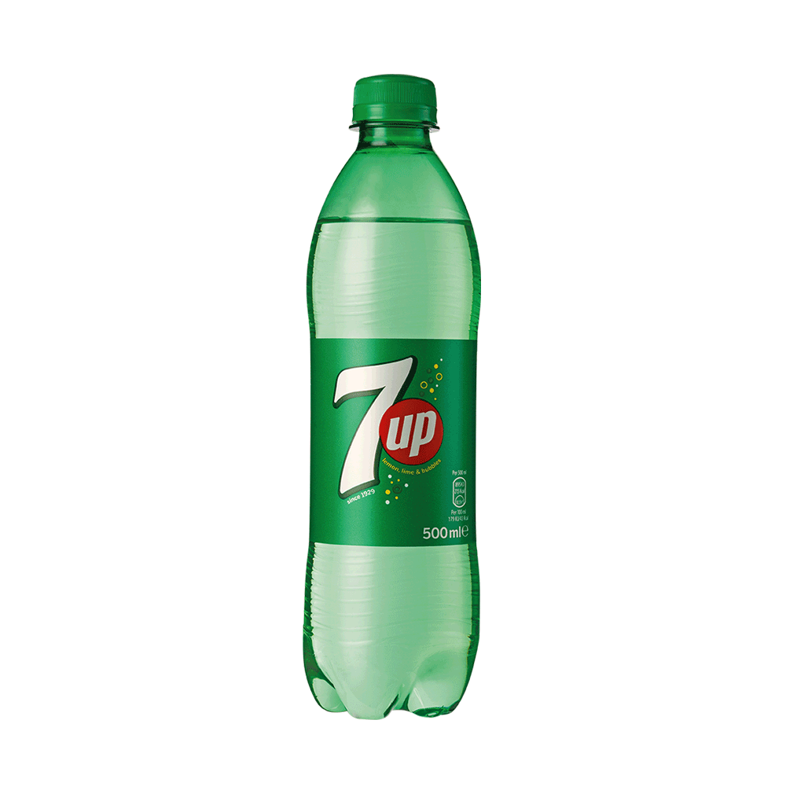
Coca Cola went to town,
Diet Pepsi knocked him down,
Dr. Pepper picked him up
And now they all drink 7-Up!
Pop, Soda, Soda, Pop!
Make a rhythm before we stop!
Pop, Soda, Soda, Pop!
Read it from the top!
A
B

Slide 2
4
4

Slide 3
4
4

Slide 4
4
4

Slide 5
4
4

Slide 6
4
4

