Slide 1
Rocky Mountain

Slide 2
Rocky mountain, rocky mountain, rocky mountain high. When you’re on that rocky mountain, hang your head and cry. Do, do, do ,do, do remember me. Do, do, do, do, do remember me.

Slide 3
Stormy ocean, stormy ocean, stormy ocean wide. When you’re on that stormy ocean, there’s no place no hide. Do, do, do ,do, do remember me. Do, do, do, do, do remember me.

Slide 4
Sunny valley, sunny valley, sunny valley low. When you’re in that sunny valley, sing it soft and low. Do, do, do ,do, do remember me. Do, do, do, do, do remember me.

Slide 7
2
4

Slide 8
2
4

Slide 9
2
4

Slide 10
2
4

Slide 11
2
4

Slide 12
2
4

Slide 20
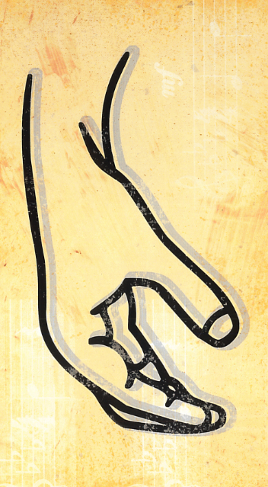
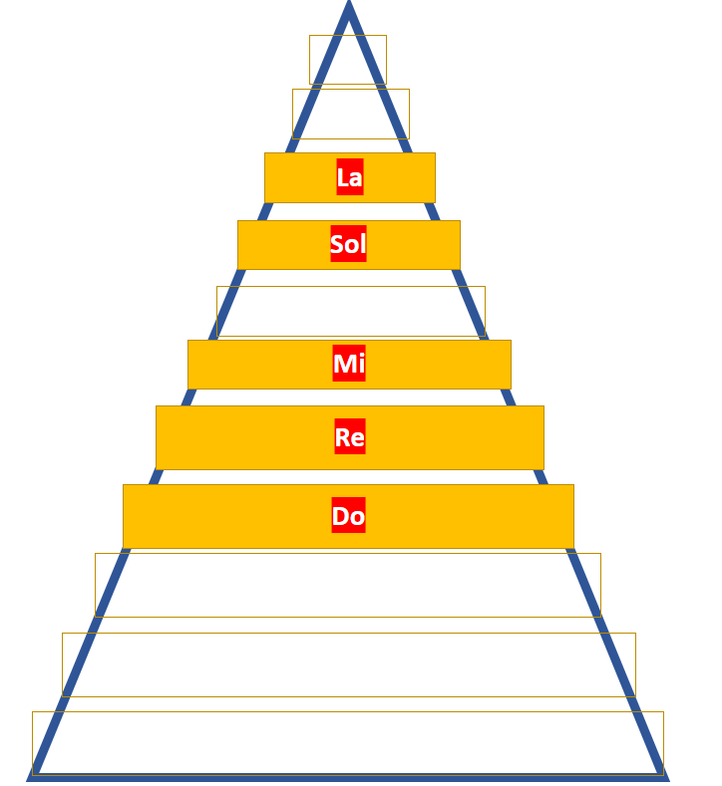
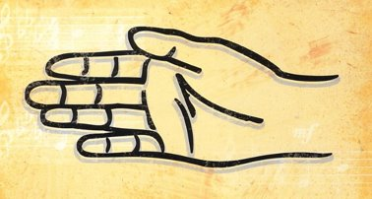
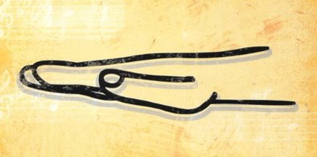
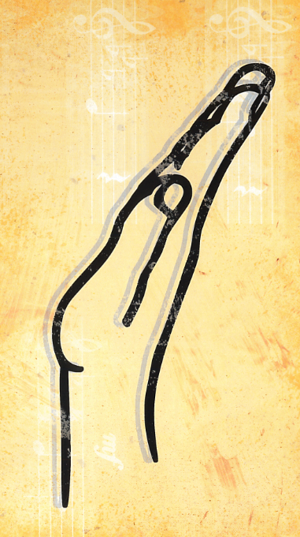
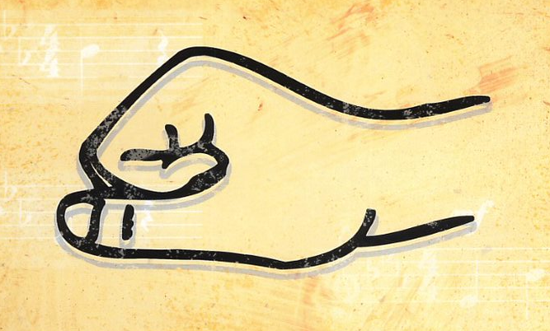
La
Sol
Mi
Re
Do

