Slide 1
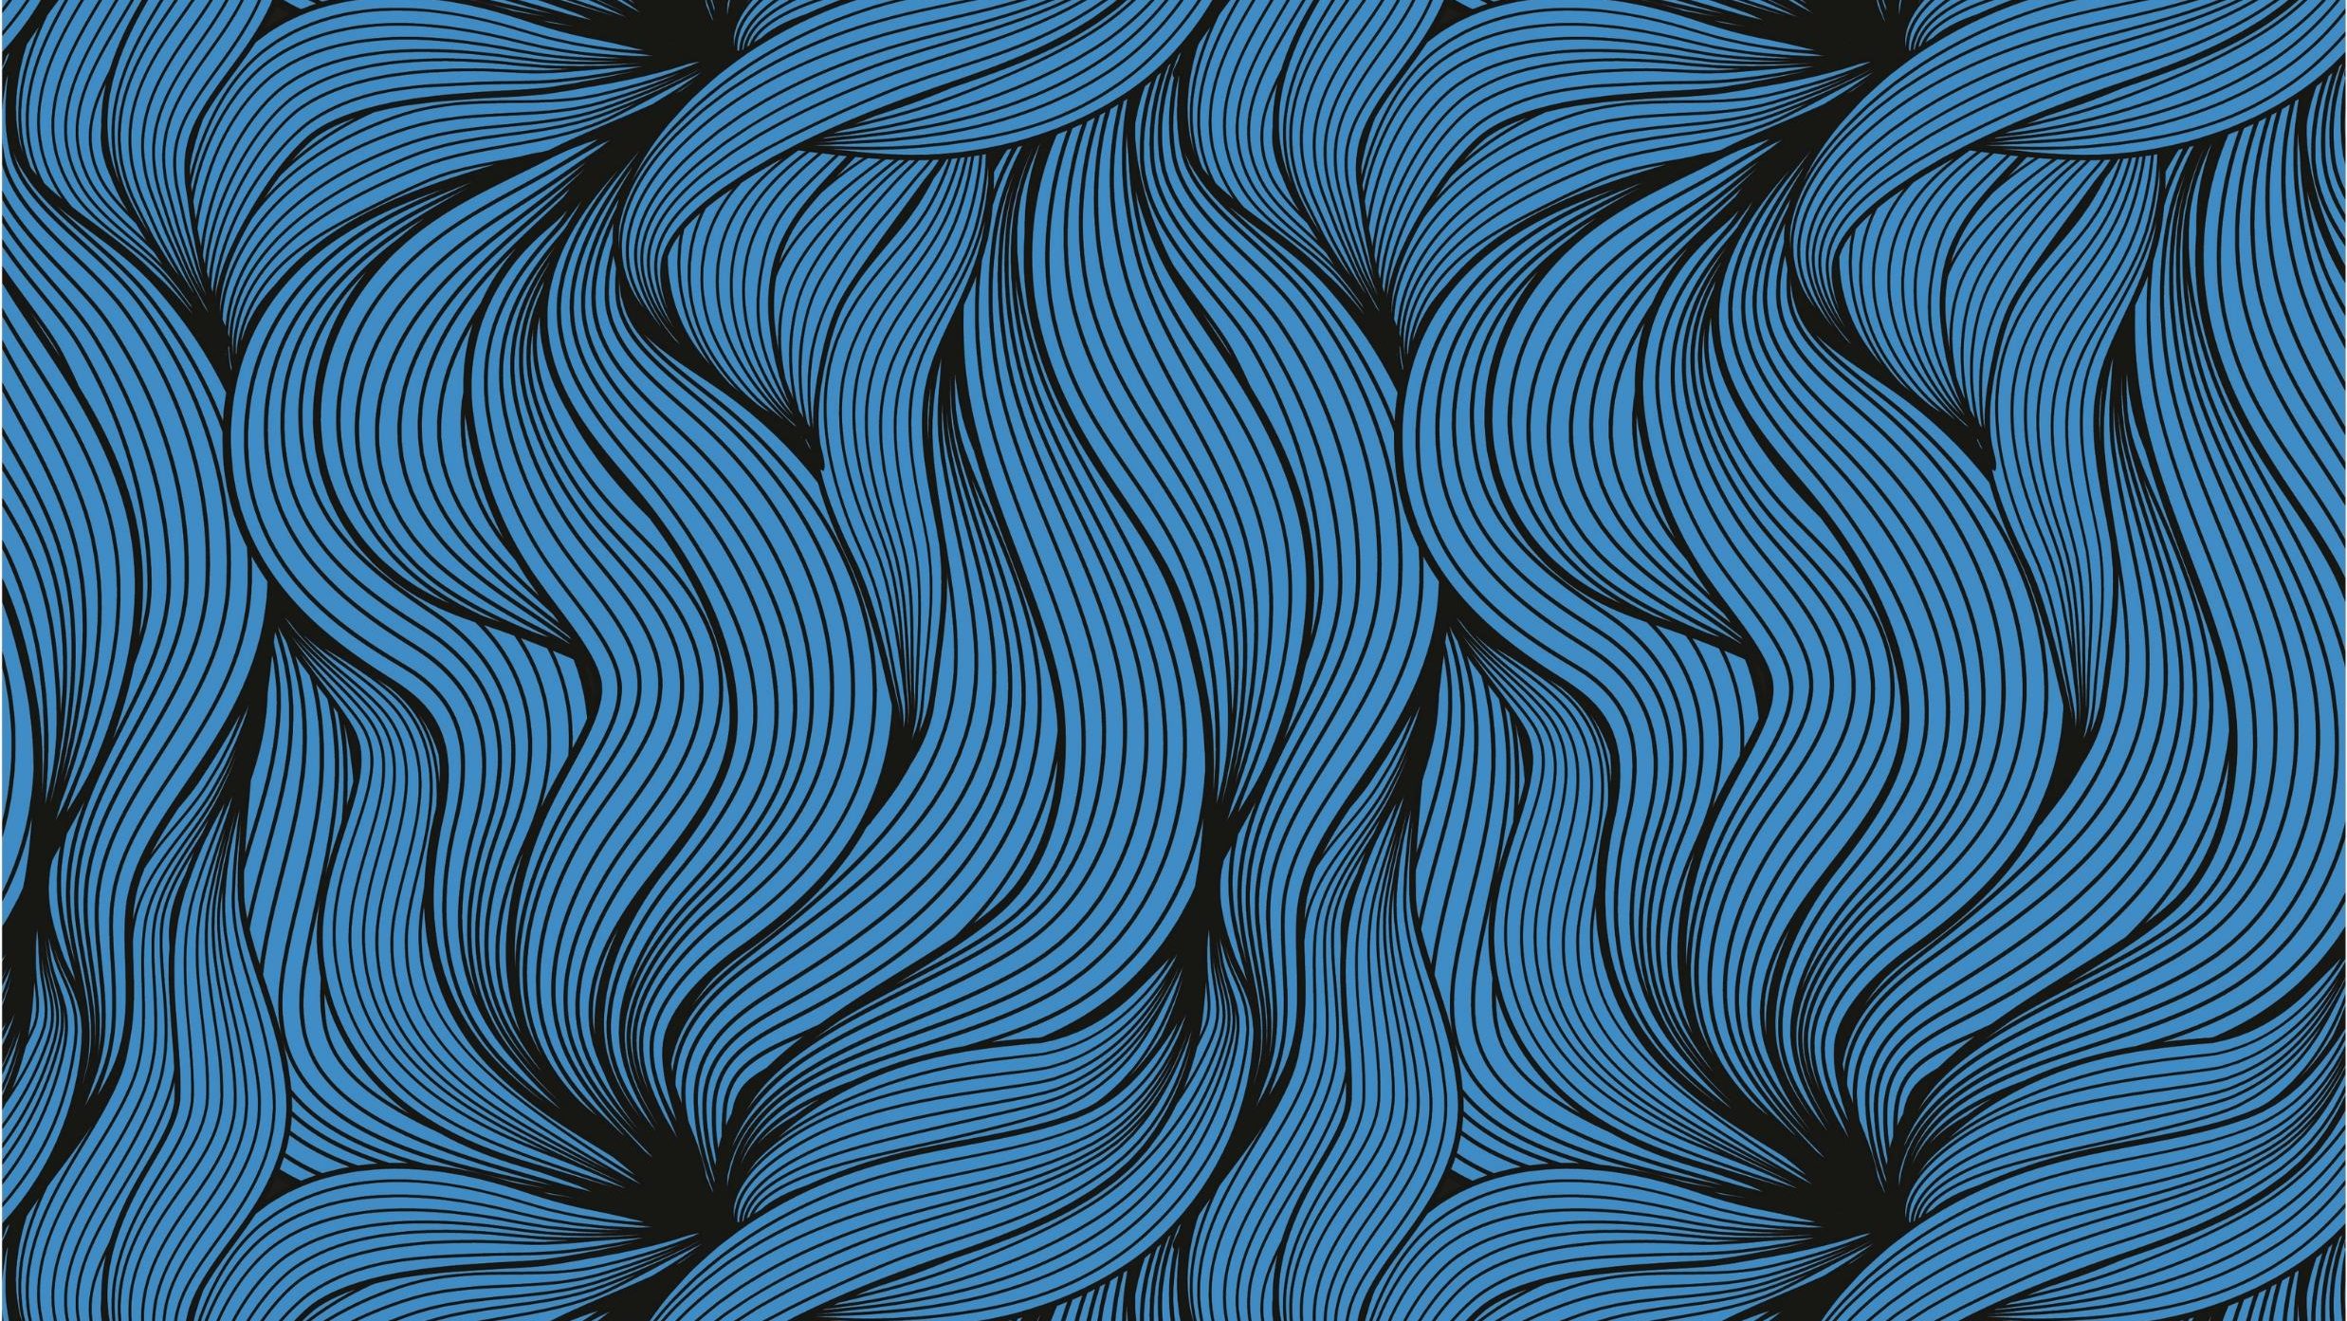
Hot Cross Buns

Slide 2
Hot Cross Buns Hot Cross Buns One a Penny, Two a Penny Hot Cross Buns

Slide 3
2

Slide 4
2

Slide 5
2

Slide 6
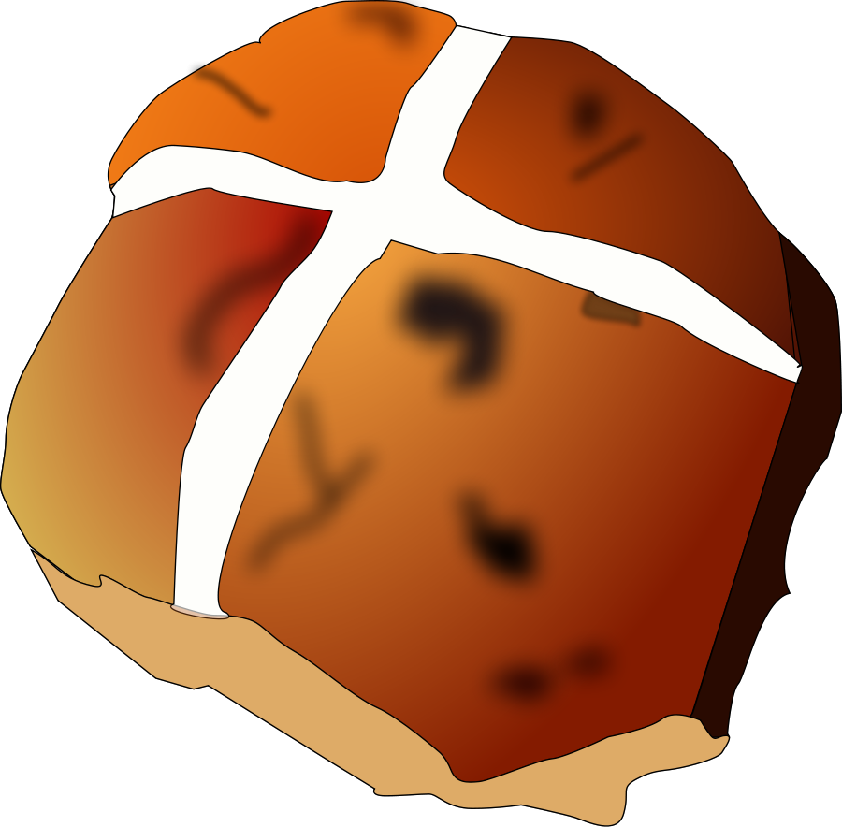
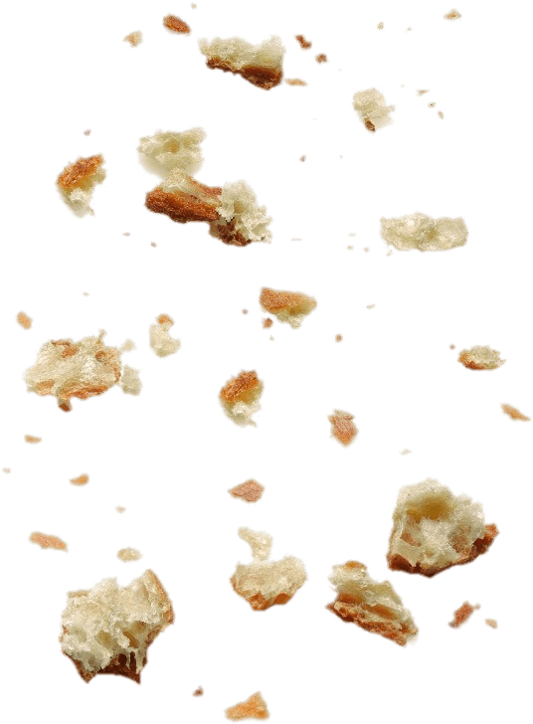
2

Slide 7
2

Slide 8
2

Slide 9
2

Slide 10
2

Slide 11
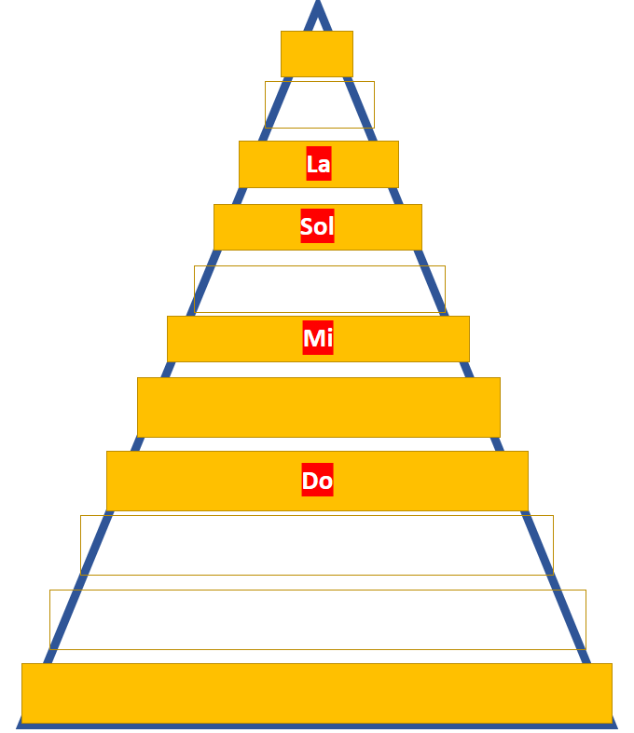
It sounds like a new note has moved onto Melody Mountain!

Slide 12
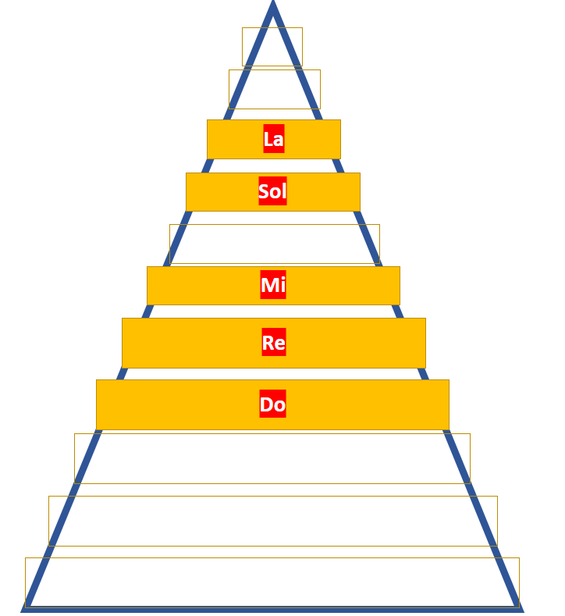
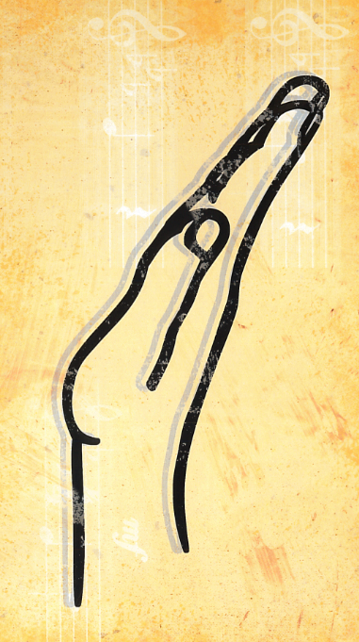
Its name is
‘Re’!

Slide 14
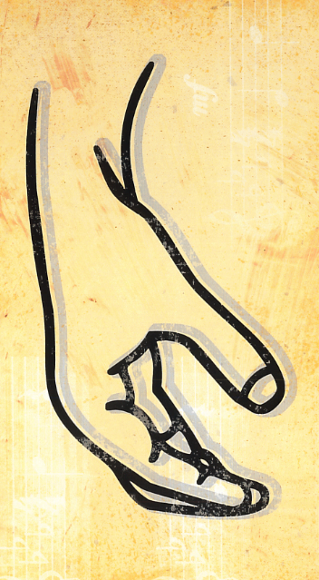
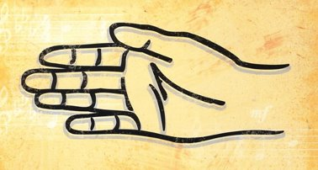
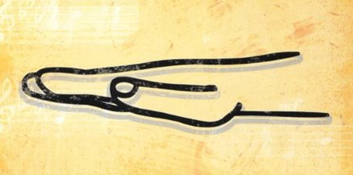
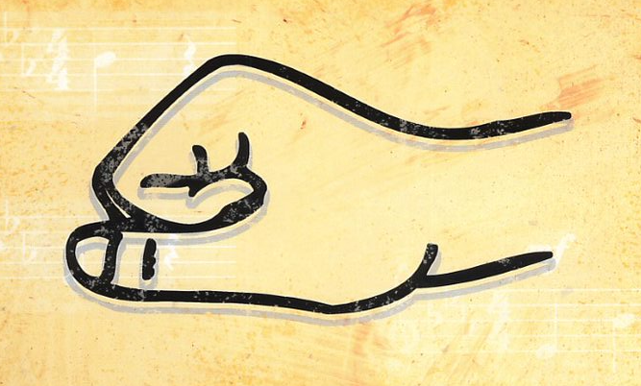
La
Sol
Mi
Re
Do

