Slide 1
Icka Backa

Slide 2
Icka Backa Soda Cracker
Icka Backa Boo
Icka Backa Soda Cracker
Out Goes You!
(Sortez Vous!)

Slide 3
4

Slide 4
4

Slide 5
4

Slide 6
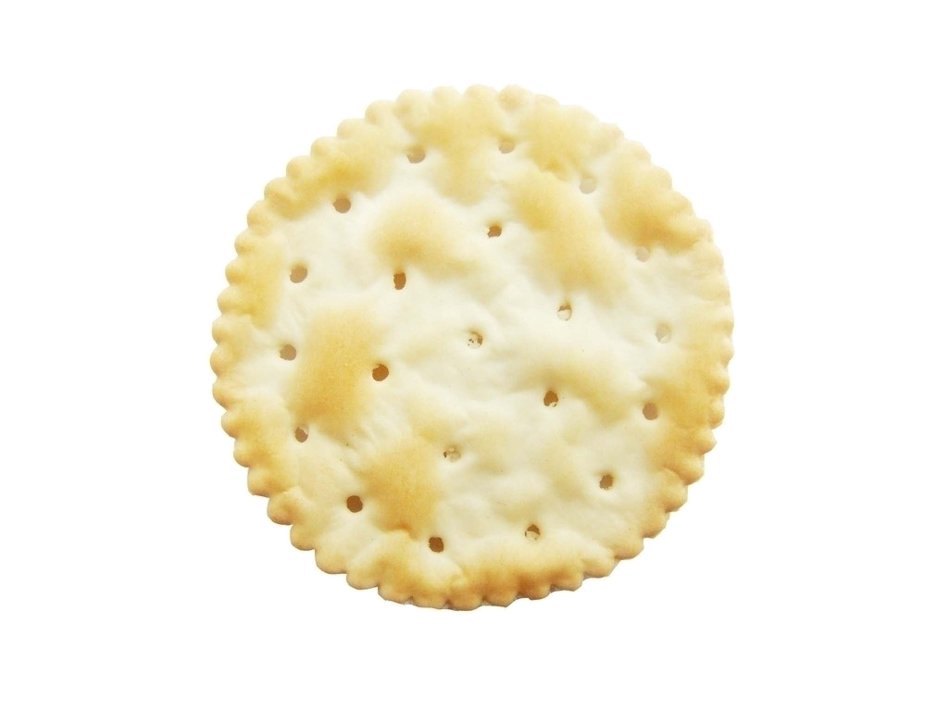
4

Slide 7
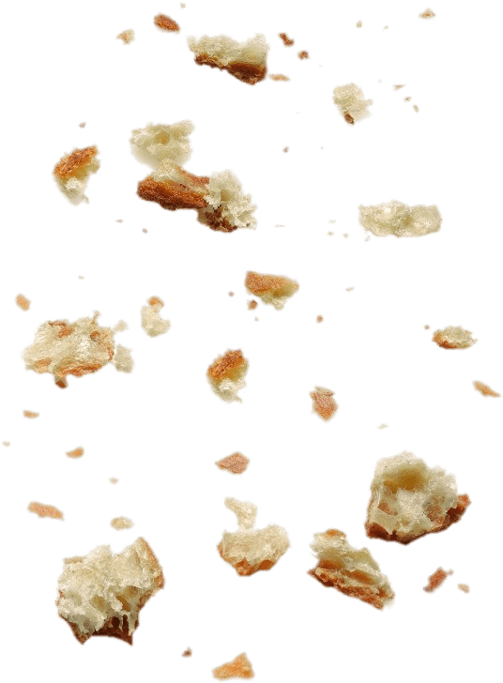
4

Slide 8
4

Slide 9
4

Slide 10
4

Slide 11
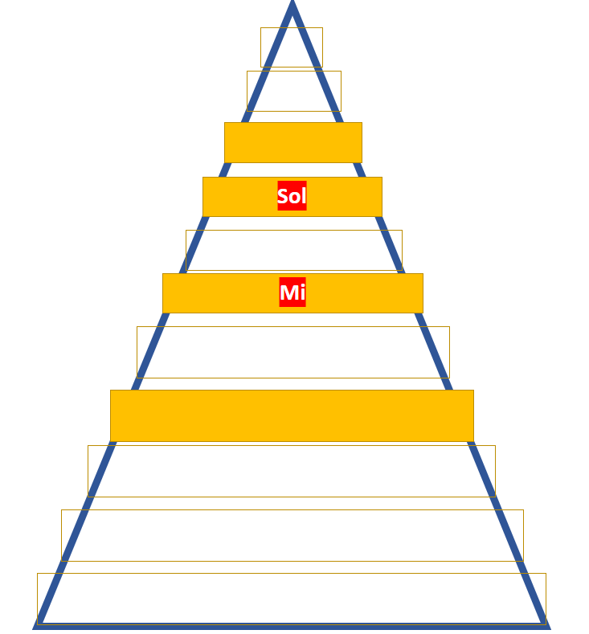
Which new note
on Melody Mountain
are we using?

Slide 12
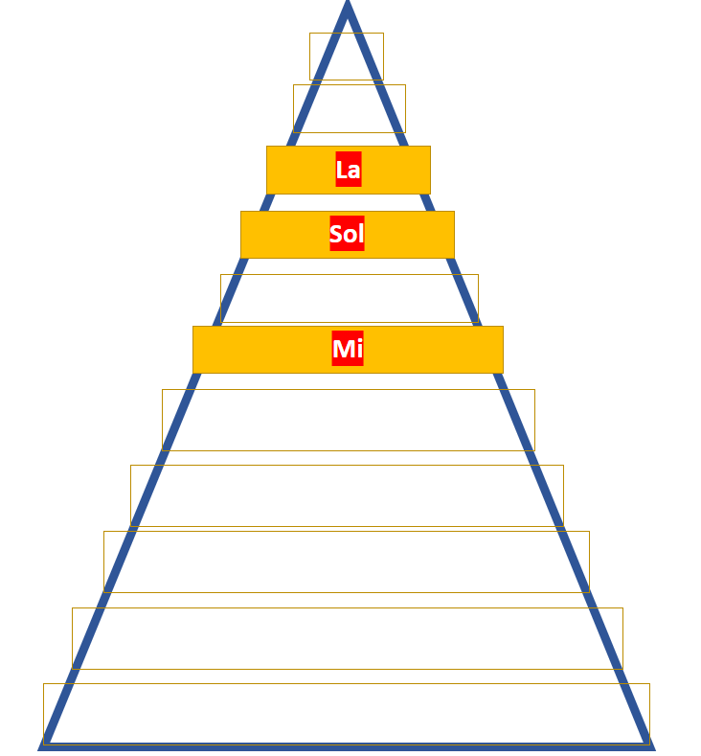
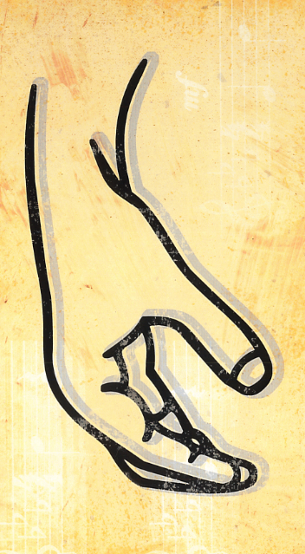
We are using ‘La’!

Slide 13
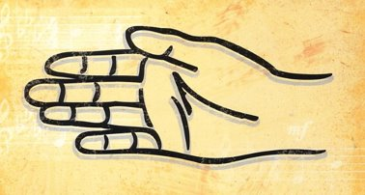
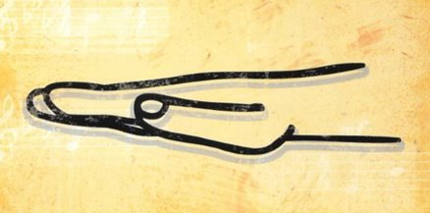
La
Sol
Mi

Slide 14
1

Slide 15
2

Slide 16
3

Slide 17
4

