Slide 1
En dansant tout le long du bois

Slide 2
En dansant tout le long du bois,
Ma clarinette a perdu sa note.
En dansant tout le long du bois,
Ma clarinette la retrouvera.

Slide 3
Woodwind Family
2
4
Clues that an instrument is part of the woodwind family:
1. The instrument is made of wood (or used to be).
2. The instrument is a cylinder with holes, and has an opening at the bottom.
3. The instrument uses a thin piece of wood called a reed.

Slide 4
2
4

Slide 5
2
4

Slide 6
2
4

Slide 7
2
4

Slide 8
2
4

Slide 9
2
4

Slide 10
2
4

Slide 11
2
4

Slide 12
2
4

Slide 13
2
4

Slide 14
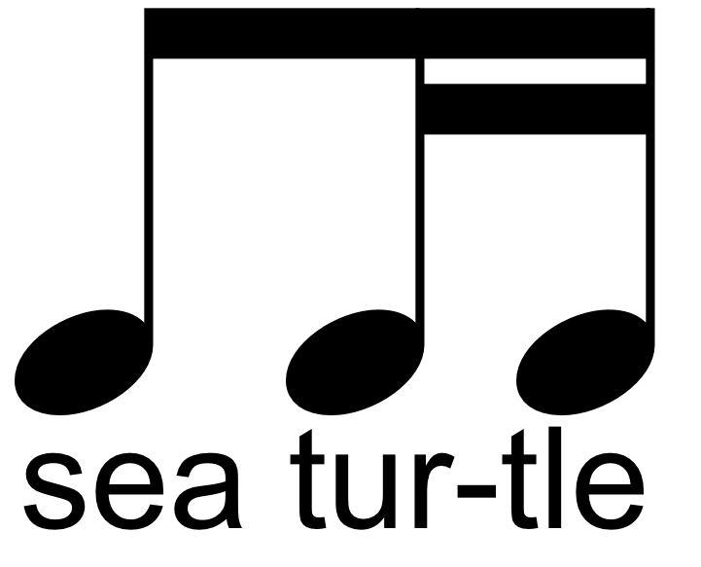
2
4

Slide 15
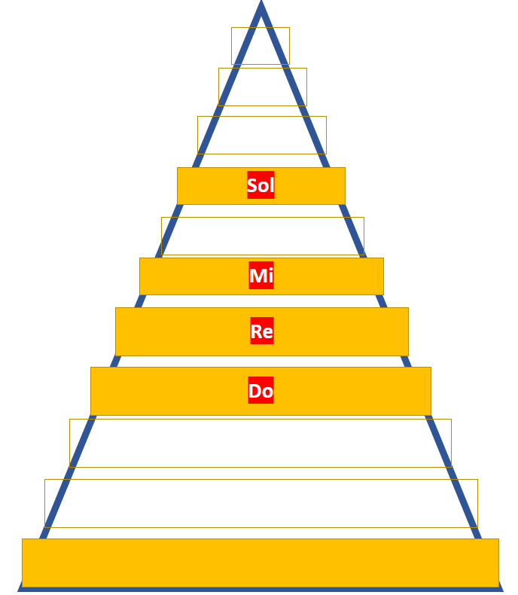
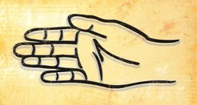
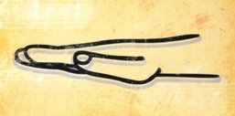
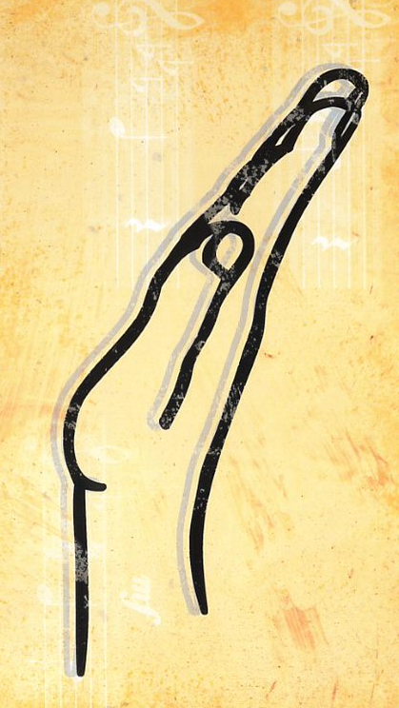
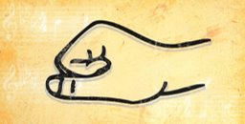
Sol
Mi
Re
Do

Slide 16
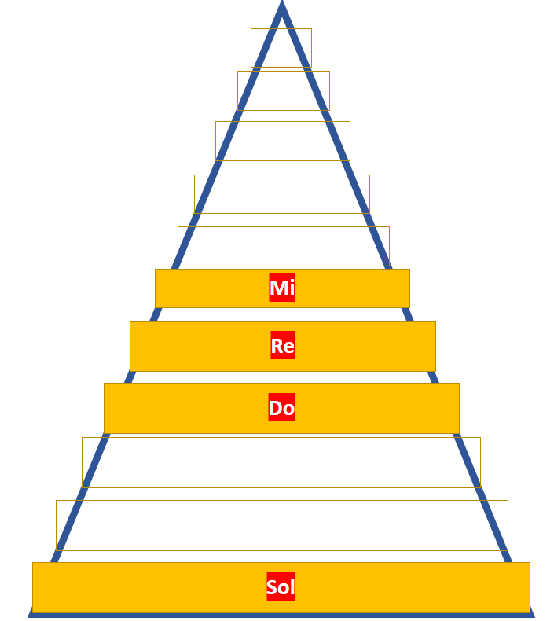
Mi
Re
Do
Sol

Slide 17
2
4
S, D
M
M-R-D-R
M
M M-M
M R-D
M R
R D
S, D
M
M-R-D-R
M
M M-M
M R-D
M R
D

