Slide 1
Bow wow wow!

Slide 2
Bow, wow, wow! Whose dog art thou? Little Tommy Tucker’s dog! Bow, wow, wow!

Slide 3
4
4

Slide 4
4
4

Slide 5
4
4
4

Slide 6
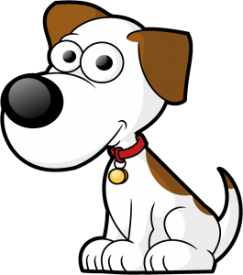
4
4
4

Slide 7
4
4
4

Slide 8
4
4
4

Slide 9
4
4
4

Slide 10
4
4
4

Slide 11
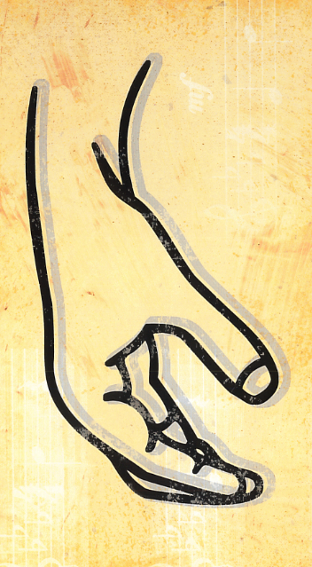
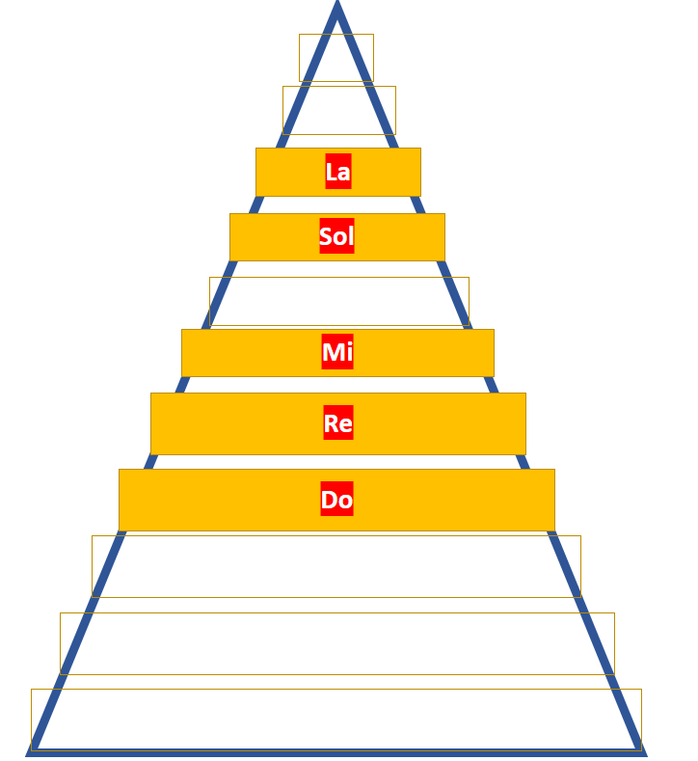
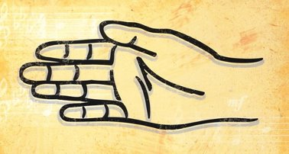
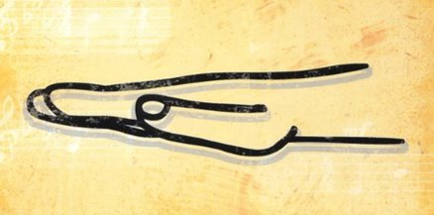
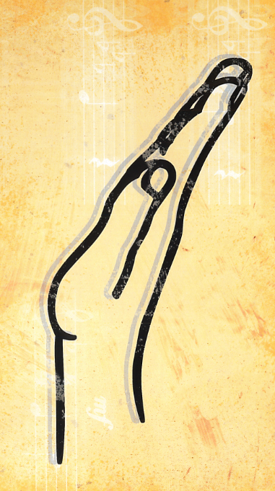
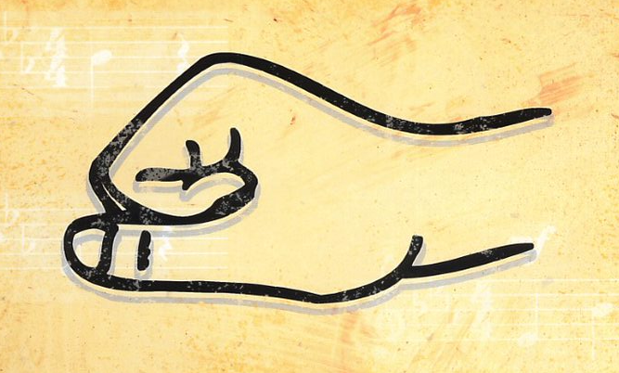
La
Sol
Mi
Re
Do

