Slide 1
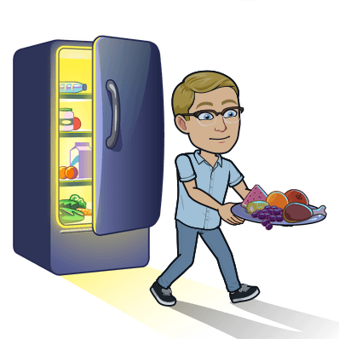
Read a new book with Mom or Dad! | Walk to school and back! | Play a board game with your family! | Play a game of soccer outside!
Shovel a neighbour’s driveway or sidewalk! | Do 100 jumping jacks! | Go sledding! | Draw a picture to give to Mom or Dad!
Turn on the radio and sing along! | Write a card and mail it to someone! | Help with the household chores! | Go on a bike ride!
Build a snow fort! | Make your own instrument! | Help Mom or Dad make dinner! | Have a family movie night!

