Slide 1
Santa Santa Where’s Your Sleigh?

Slide 2
Santa, Santa, where’s your sleigh?
Someone stole it yesterday!
Who stole my sleigh?
I stole your sleigh!

Slide 3
4

Slide 4
4

Slide 5
4

Slide 6
4

Slide 7
4

Slide 8
4

Slide 9
4

Slide 10
4

Slide 11
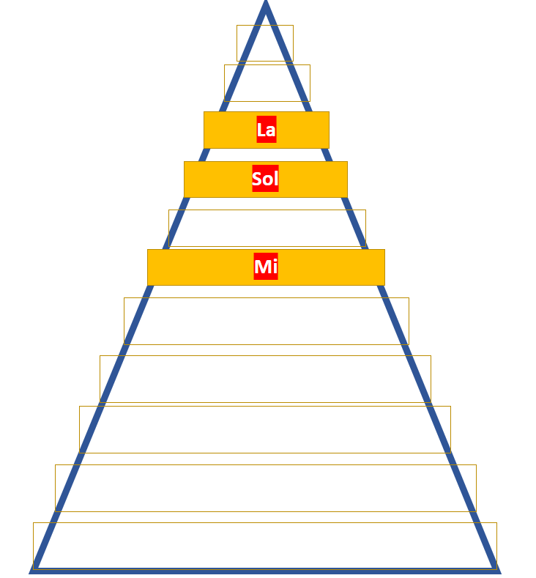
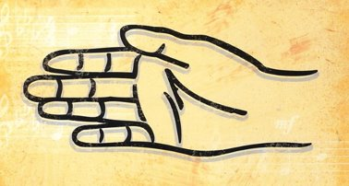
La
Sol
Mi

Slide 12
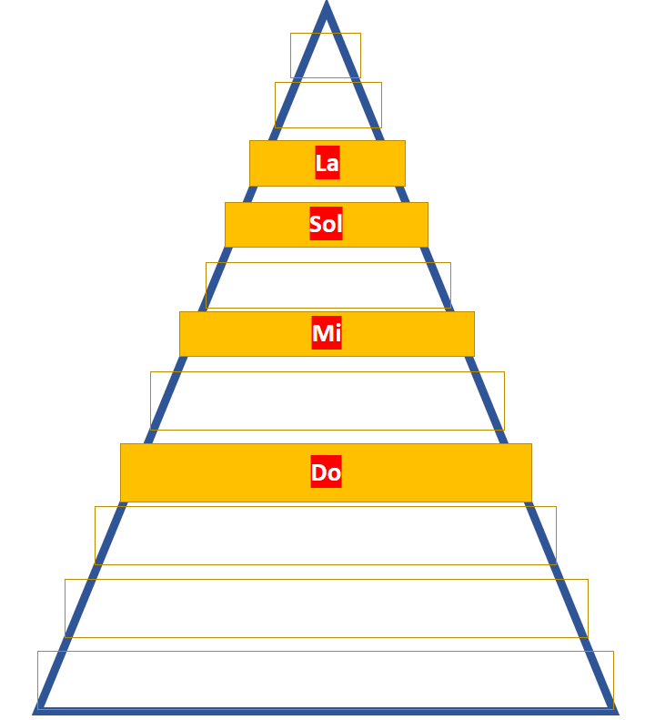
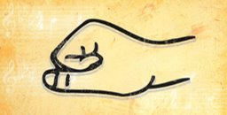
La
Sol
Mi
Do

