Slide 1
Engine Engine #9
Engine Engine Number 9,
going down the railroad line.
If the train goes off the tracks
Will I get my money back?

Slide 2
2

Slide 3
2

Slide 4
2

Slide 5
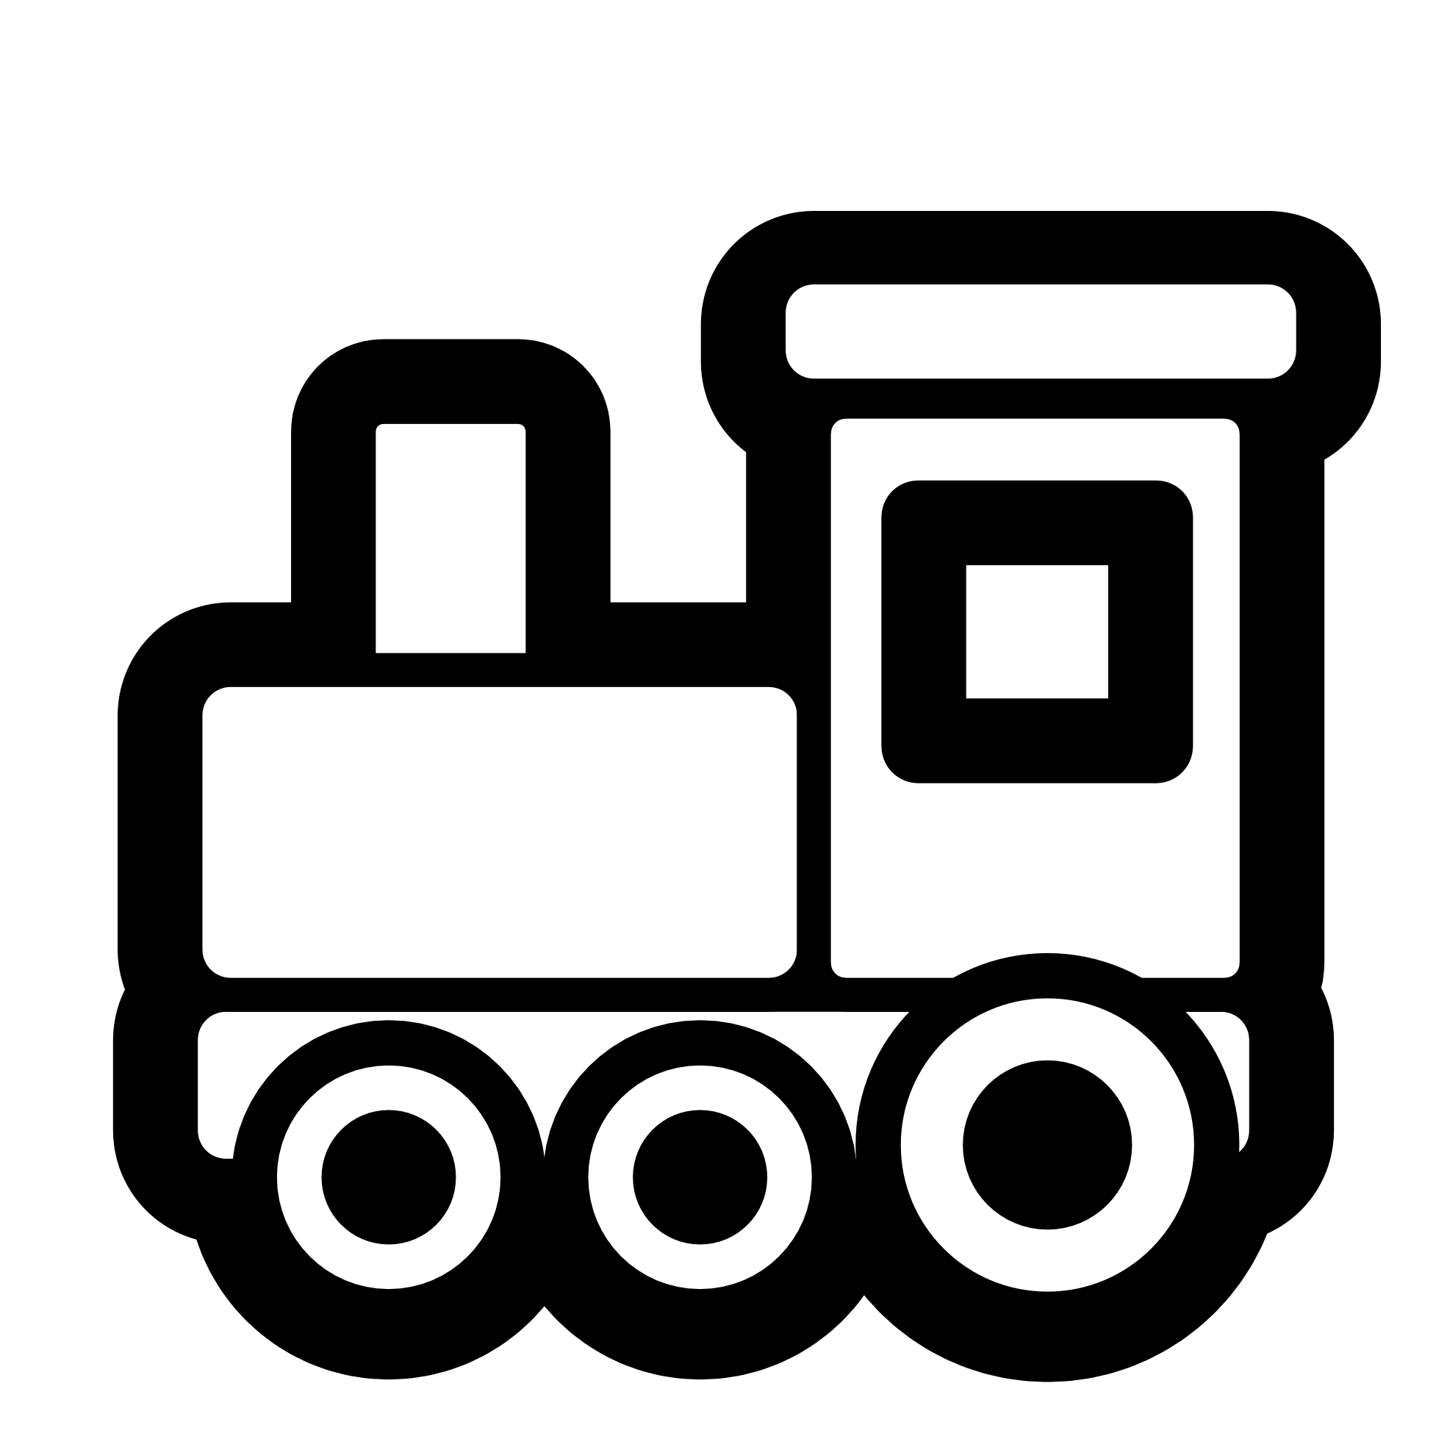
2

Slide 6
2

Slide 7
2

Slide 8
2

Slide 9
2

Slide 10
2

Slide 11
2

Slide 12
2

Slide 13
2

Slide 14
2

Slide 15
2

Slide 16
2

Slide 17
2

Slide 18
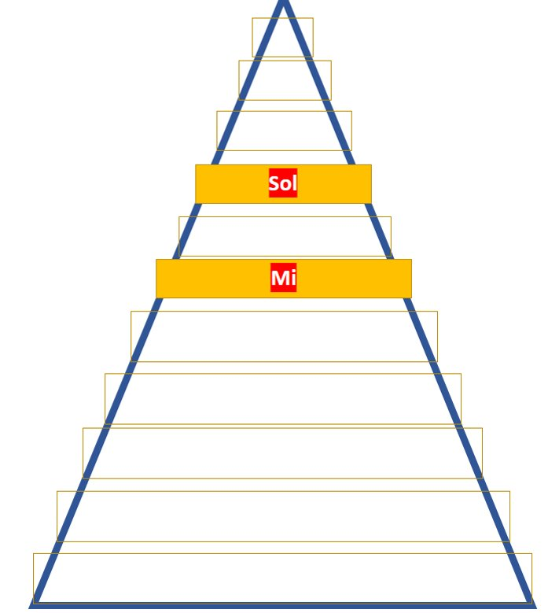
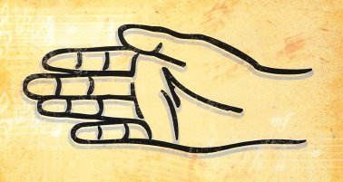
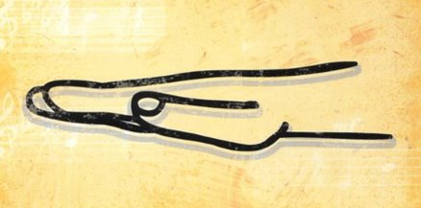
Sol
Mi

