Slide 1
Cuckoo, where are you?
Cuckoo, where are you?
Sol – Mi! Sol – Mi!

Slide 2
Cuckoo, où es tu?
Cuckoo, où es tu?
Sol – Mi ! Sol – Mi!

Slide 3
4

Slide 4
4

Slide 5
4

Slide 9
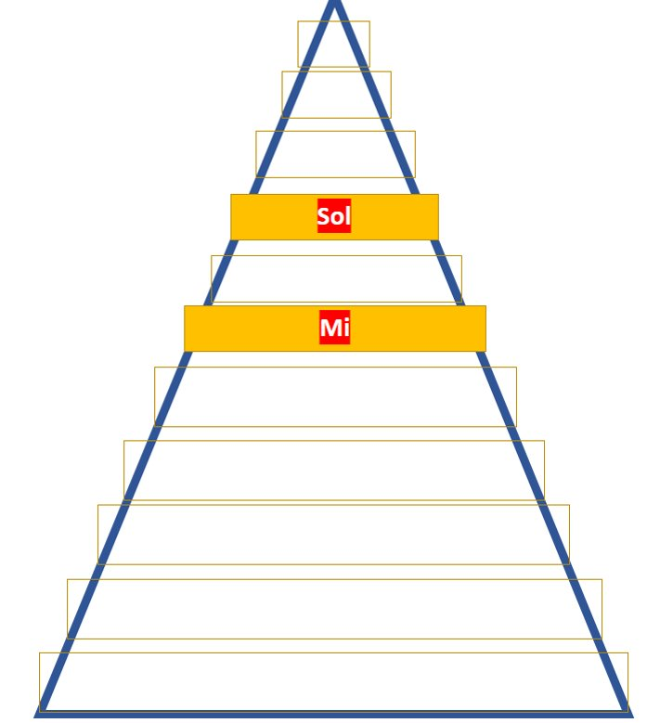
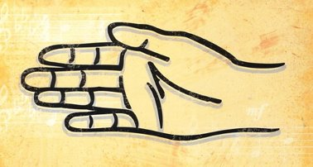
Sol
Mi

Slide 10
Sol Mi Sol-Sol Mi
Sol Mi Sol-Sol Mi

