Slide 1
Doggie, doggie where’s your bone? Someone stole it from your home! Who has my bone? I have your bone!

Slide 2
4

Slide 3
4

Slide 4
4

Slide 5
4

Slide 6
4

Slide 7
4

Slide 8
4

Slide 9
4

Slide 10
4

Slide 11
4

Slide 12
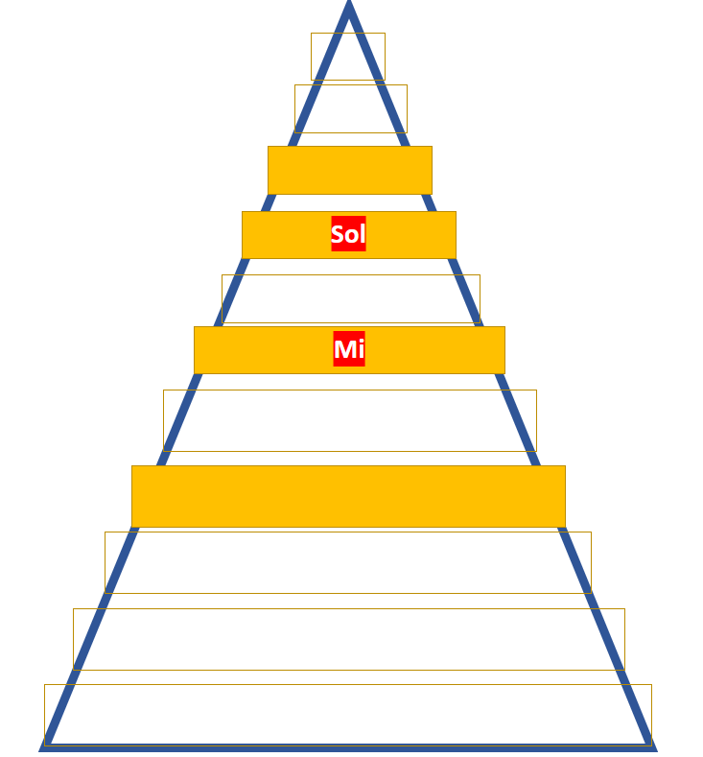
Which new note on Melody Mountain are we using?

Slide 13
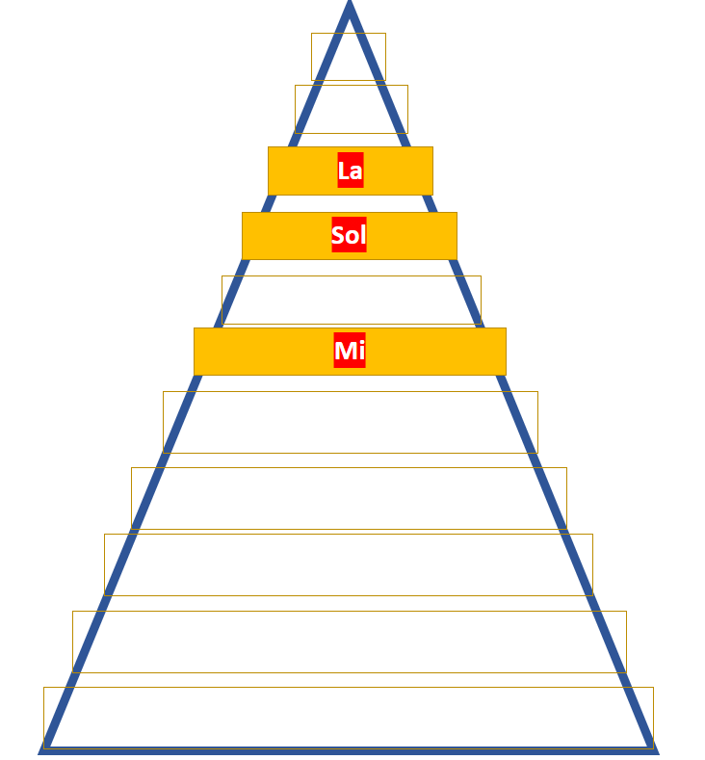
We are using ‘La’!

Slide 14
4

Slide 15
4

Slide 16
4

Slide 17
4

Slide 18
4
S-S M-M S-S M S-S M-L S-S M
S M-L S M S M-L S M

Slide 19
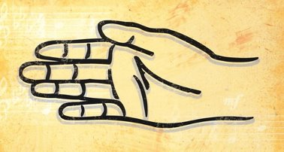
La
Sol
Mi

