Slide 1
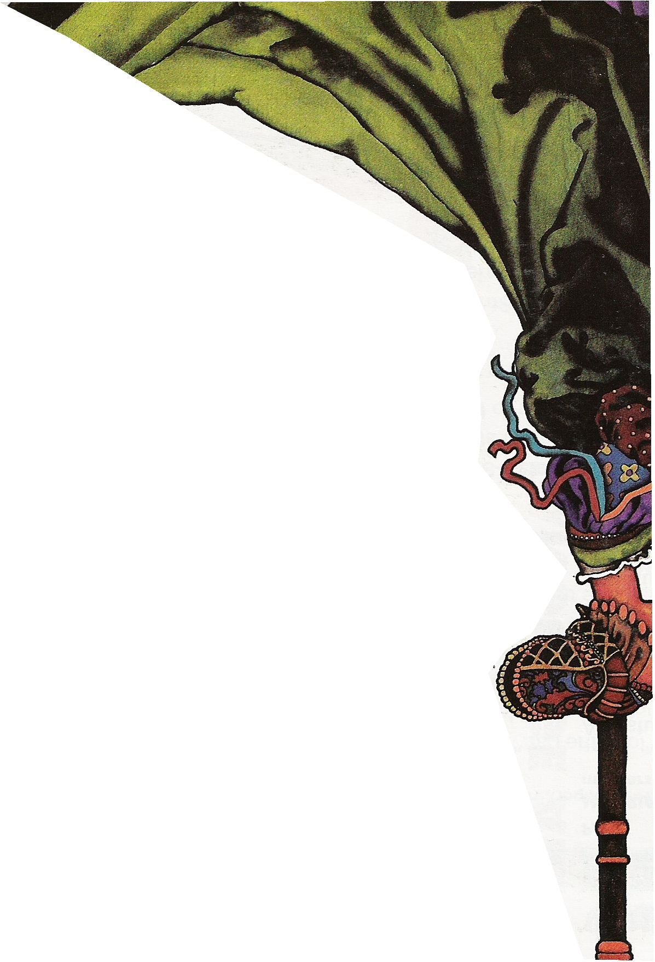
The Court
of
King Carraticus

Slide 2
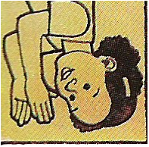
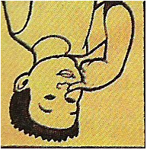
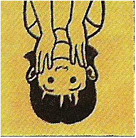
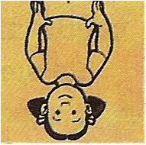
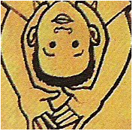
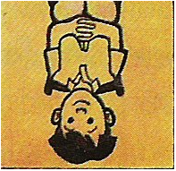
If you want to take a photo of
the powder on
the noses of
the faces of
the ladies of
the palace of
the court of
King Carraticus
is just passing by.
Oh,

Slide 3
If you want to take a photo of
the powder on
the noses of
the faces of
the ladies of
the palace of
the court of
King Carraticus
is just passing by.
Oh,

Slide 4
If you want to take a photo of
the powder on
the noses of
the faces of
the ladies of
the palace of
the court of
King Carraticus
are just passing by.
Oh,

Slide 5
If you want to take a photo of
the powder on
the noses of
the faces of
the ladies of
the palace of
the court of
King Carraticus
are just passing by.
Oh,

Slide 6
If you want to take a photo of
the powder on
the noses of
the faces of
the ladies of
the palace of
the court of
King Carraticus
are just passing by.
Oh,

Slide 7
If you want to take a photo of
the powder on
the noses of
the faces of
the ladies of
the palace of
the court of
King Carraticus
is just passing by.
Oh,

Slide 8
If you want to take a photo of
the powder on
the noses of
the faces of
the ladies of
the palace of
the court of
King Carraticus…

Slide 9
It’s too late!
They just
passed by!

Slide 10
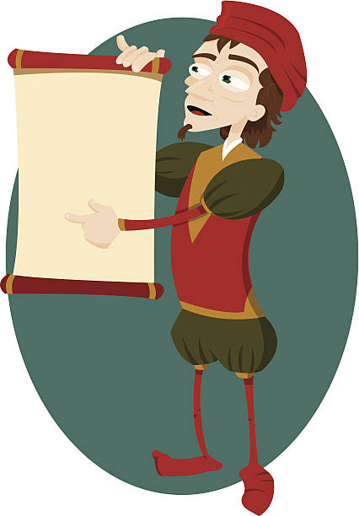
Hear ye! Hear ye!
King Carraticus,
Ruler of All That Is Good
has decreed that his
subjects shall commence
to making merry
with clanging of the cymbal
and playing of the drum.
Long live the King!

Slide 11
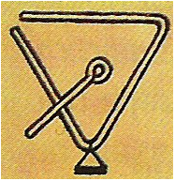
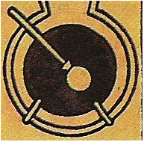
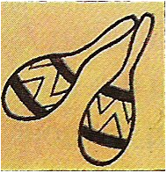
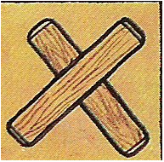
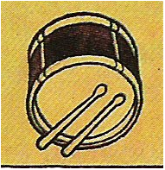

Slide 12
If you want to take a photo of
the powder on
the noses of
the faces of
the ladies of
the palace of
the court of
King Carraticus
is just passing by.
Oh,

Slide 13
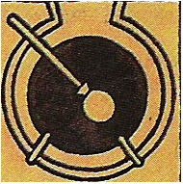
If you want to take a photo of
the powder on
the noses of
the faces of
the ladies of
the palace of
the court of
King Carraticus
is just passing by.
Oh,

Slide 14
If you want to take a photo of
the powder on
the noses of
the faces of
the ladies of
the palace of
the court of
King Carraticus
are just passing by.
Oh,

Slide 15
If you want to take a photo of
the powder on
the noses of
the faces of
the ladies of
the palace of
the court of
King Carraticus
are just passing by.
Oh,

Slide 16
If you want to take a photo of
the powder on
the noses of
the faces of
the ladies of
the palace of
the court of
King Carraticus
are just passing by.
Oh,

Slide 17
If you want to take a photo of
the powder on
the noses of
the faces of
the ladies of
the palace of
the court of
King Carraticus
is just passing by.
Oh,

Slide 18
If you want to take a photo of
the powder on
the noses of
the faces of
the ladies of
the palace of
the court of
King Carraticus…
.

Slide 19
It’s too late!
They just
passed by!

