Slide 1
Leaves are falling,
falling falling
Leaves are falling to the ground.

Slide 2
C’est l’automne,
Les feuilles tombent,
Elles tombent sur le sol.

Slide 7
High / Aigu
Low / Grave​

Slide 8
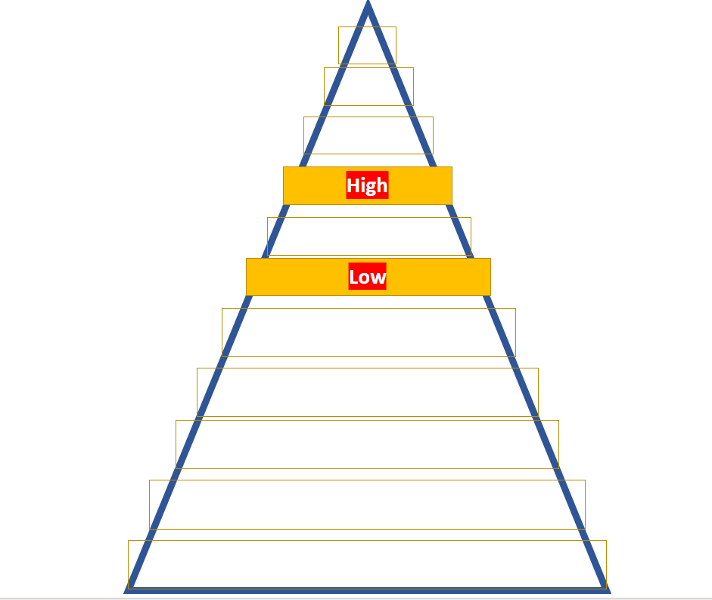

Slide 9
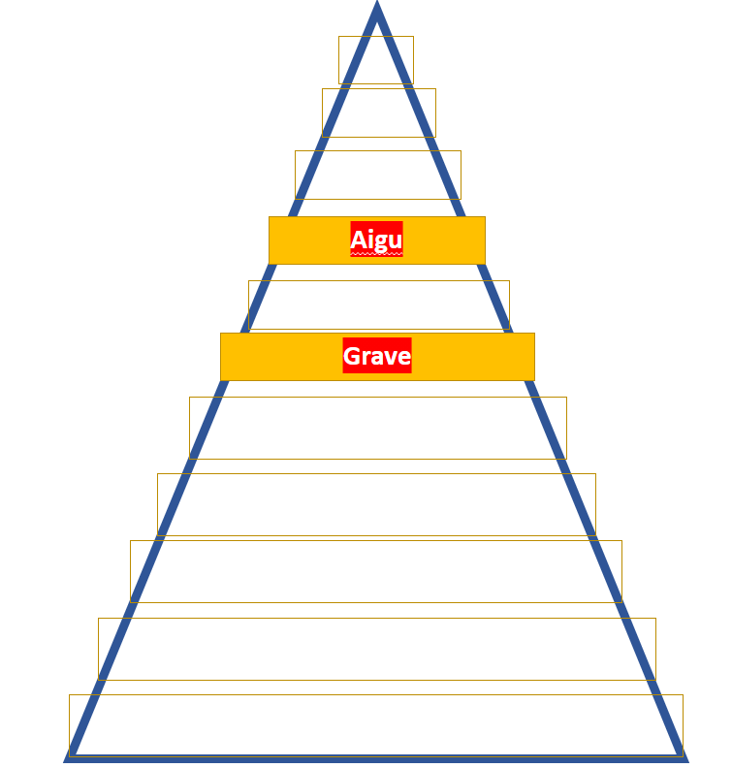

Slide 10
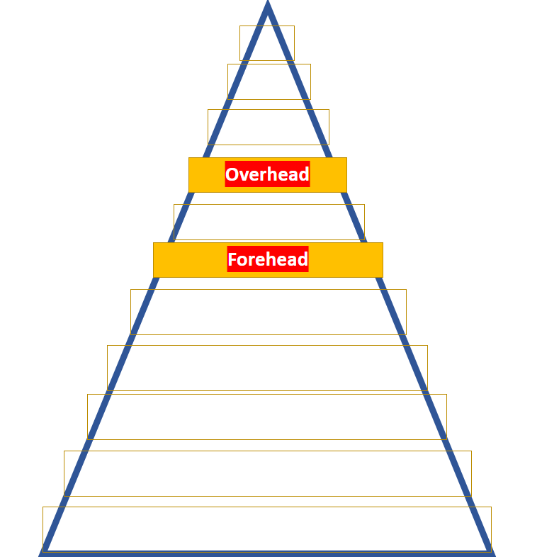

Slide 11
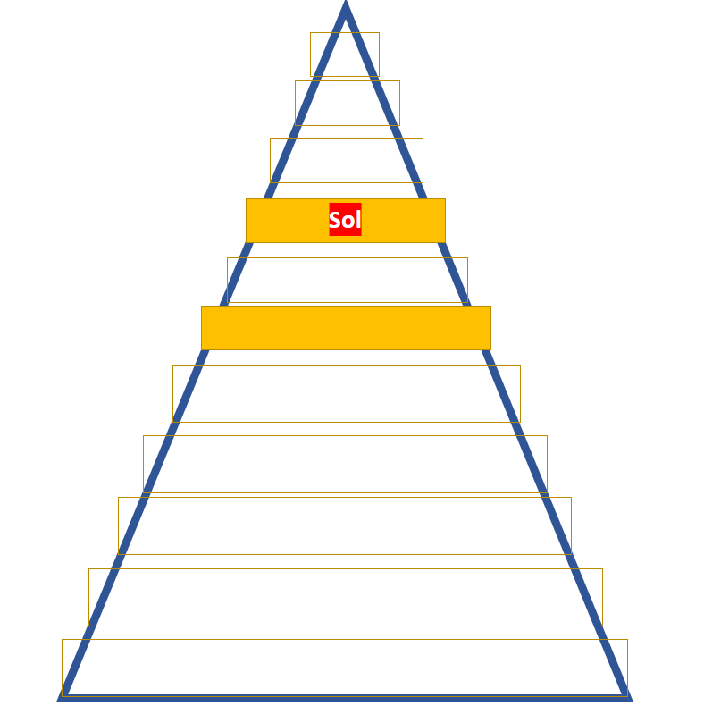
A new note has moved onto melody Mountain!
Its name is ‘Sol’.

Slide 12
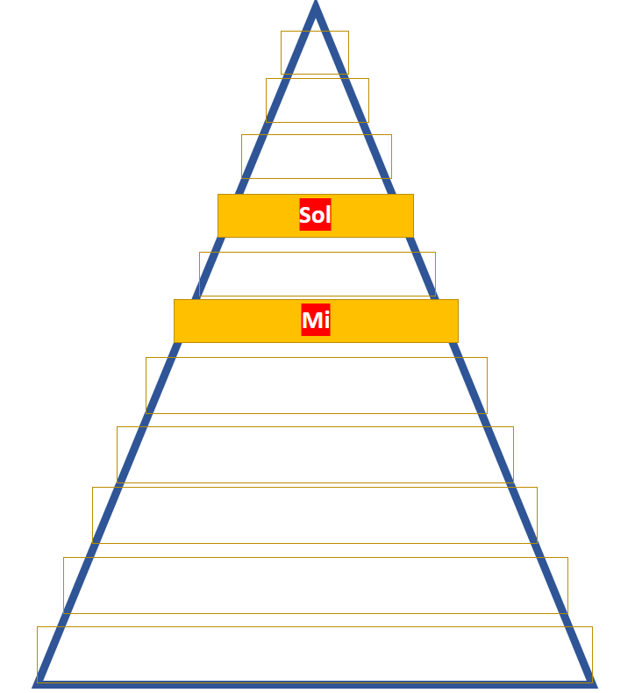
It looks like ‘Sol has a neighbor on Melody Mountain!
Its name is ‘mi’.

Slide 13
Sol
Mi

Slide 14
Sol
Mi
?

