Slide 1
Mariachi Music

Slide 2
What is Mariachi Music?
Mariachi music is the traditional music of Mexico.

Slide 3
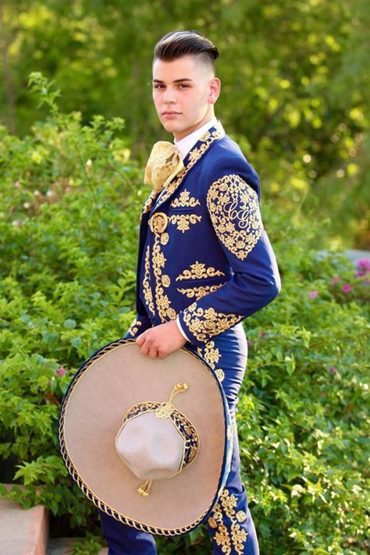
What do Mariachis wear?
Performers often wear the charro costume.

Slide 4
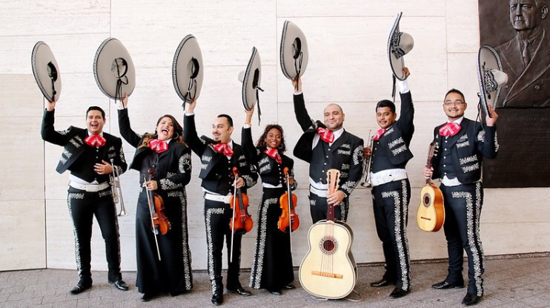
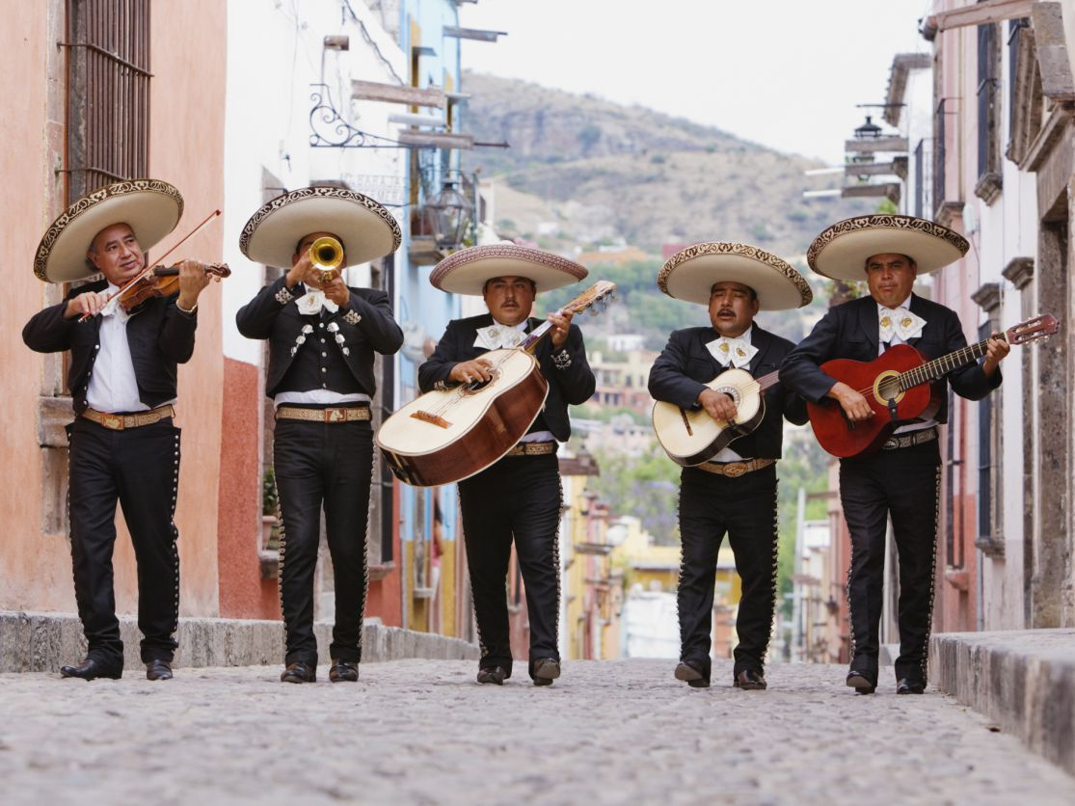
What do mariachis play?
Here is the typical instrumentation of a mariachi band:
6-8 violins
2 trumpets,
1 guitar.
1 vihuela (a high-pitched, round-backed guitar)
1 guitarrón (a deep-voiced guitar)
1 Mexican folk harp.

Slide 5
La Fiesta Del Mariachi
by
Luis Miguel

